Slide 1

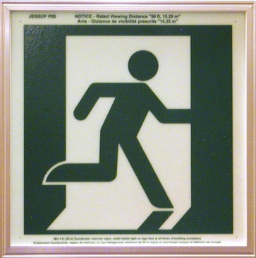
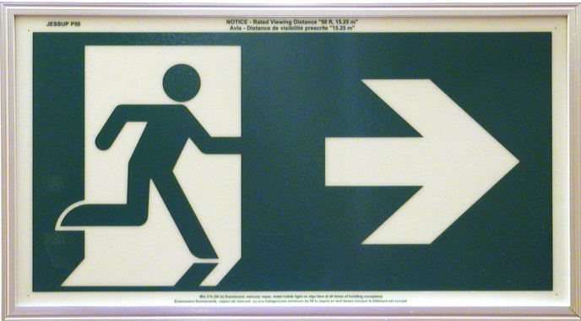
Canada’s Leader in PL Technology for Two Decades
Photoluminescent Safety Products
Understanding the Technology and Today’s Marketplace
© 2016 PL Solutions. All rights reserved. Please do not copy or redistribute.

Slide 2
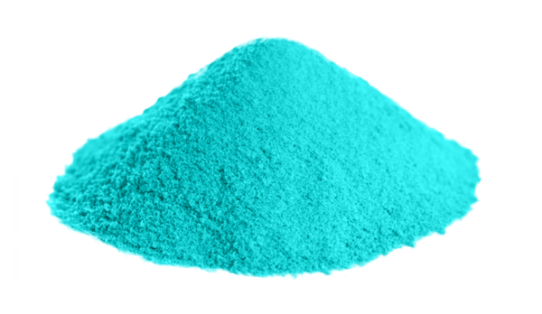
Photoluminescent (PL)
  What is Photoluminescent?
  In North America, PL products are now one of the fastest growing technologies that address energy conservation, environmental initiatives and life safety.
  Strontium Aluminate is a solid, odorless, non-flammable, pale yellow mineral. It is chemically and biologically inert.
        A proprietary laboratory process, which is 100%
        non-toxic using catalysts that are environmentally friendly. The PL absorbs any ambient area lighting and then emits that light once power is lost or an emergency condition occurs.
© 2016 PL Solutions. All rights reserved. Please do not copy or redistribute.

Slide 3
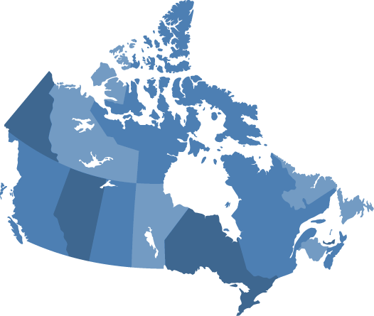




Codes and Standards Overview
All Provinces Across Canada
Fully acceptable technology as indicated in Section 3.4.5 of the National Building Code
Use of Photoluminescent (PL) signs have been adopted by every Province in Canada
All Externally Illuminated signs must conform to – CAN/ULC-S572 Standard
PL SOLUTIONS IS APPROVED TO BE CHARGED WITH ONLY 2 FOOT CANDLES OF LIGHT
PL SIGNS DO NOT REQUIRE CONTINUOUS ILLUMINATION FROM OTHER SOURCES
PL SIGNS ARE CONSIDERED THEIR OWN POWER SOURCE, LIKE SOLAR PANELS
PL SIGNS ARE LEED QUALIFIED, WITH NO GHG EMISSIONS
PL SIGNS ARE ALSO UL 924 APPROVED FOR THE UNITED STATES
IN CANADA,THERE ARE OVER 100,000,000 EXIT SIGNS
IN THE U.S.A. THERE ARE OVER 1 BILLION EXIT SIGNS (SOURCE;N.E.M.A.)
© 2016 PL Solutions. All rights reserved. Please do not copy or redistribute.

Slide 4
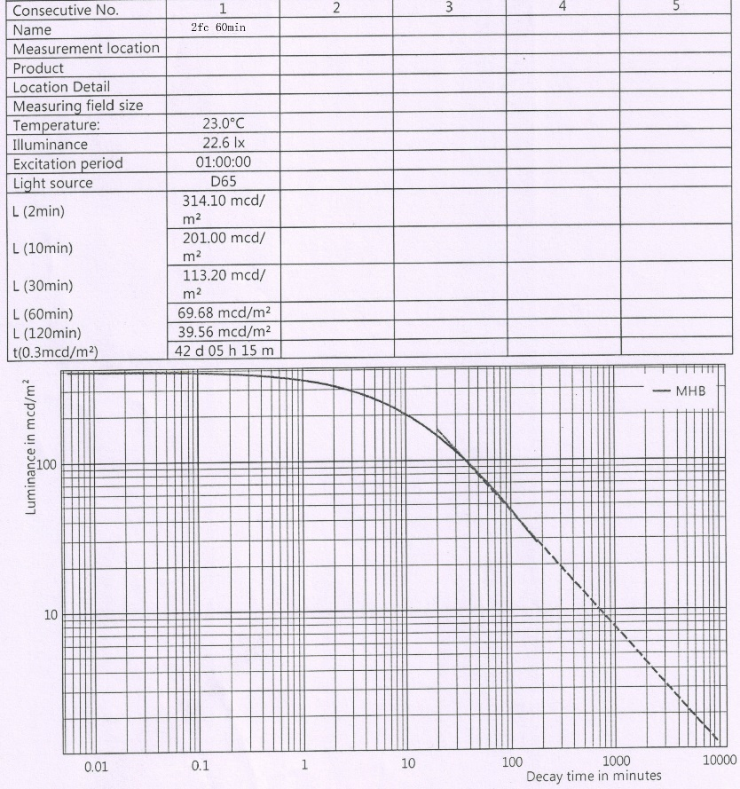

PL Solutions Surpasses Code
To pass code for 2FC / 120 min, CAN/ULC-S572 requires minimum of 5mcd/m2 at 120 min.
At 120 min, our signs are still at 39.46mcd/m2. Almost 8 times what is required.
Our signs reach 5mcd/m2 at 5000 min (or 3.5 days)
We are setting new standards in the industry.
© 2016 PL Solutions. All rights reserved. Please do not copy or redistribute.

Slide 5
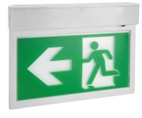

Comparing Technologies
Electrically Powered to Non-Electrical
 | LED | PL
Pricing | $350+ | $175.00+
Product Guarantee | 1-2 Years | 25 Years
Electricity | Yes | No
Regular Maintenance | Yes | Minimal
Mandatory Testing | Yes | No
Toxic / GHG Emissions | Yes | No
Always work? | No | Yes
© 2016 PL Solutions. All rights reserved. Please do not copy or redistribute.

Slide 6
Energy, Environmental, Maintenance Analysis
1,
YEARLY IMPACT-1,000 signs | LED | INCANDESCENT
Maintenance Costs | $62,370.00 | $94,260.00
Energy Savings | $6,570 | $39,420
Environmental Savings- Lbs of CO2 | 67,452 | 404,712
NEW CONSTRUCTION | NO DEDICATED CIRCUIT BREAKER REQUIRED
IMAGINE THE IMPACT OVER 25 YEARS.
© 2016 PL Solutions. All rights reserved. Please do not copy or redistribute.

Slide 7

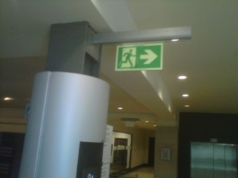
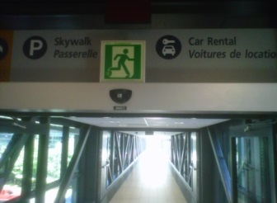
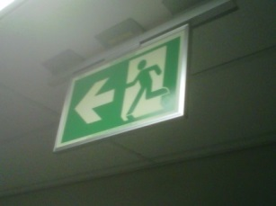
Example of a Customer Comment
S
February 2014
RE: PHOTOLUMINESCENT SIGNAGE
Dear Bob,
In my opinion photoluminescent signage is a product whose time has come. This technology has proven to us to be a very positive solution to exit signage problems. We recently converted the entire
We converted our building from LED exit signage which was prone to failure. Very disappointed with the failure rate of the LED technology in exit fixtures. Also when the supplier was contacted to discuss the problem of failure and in two incidences fire and smoke from the fixture, their only concern was how old was the unit. Over two years, no warranty. No concern about what possibly caused the failure.
Regards, Earl Arcand
Supervisor Electrical Maintenance
Ottawa MacDonald Cartier International Airport
NATIONAL DEFENCE-NOVA SCOTIA
OUR PL SIGNS SAVE ON ENERGY, MAINTENANCE, AND COSTS.THEY ALWAYS WORK, AND WE RECOMMEND PL SOLUTIONS AND BOB TO ANY POTENTIAL CLIENT,
DEAN COLLIER, P.ENG.
UNIVERSITY OF WINDSOR
WE WERE DELIGHTED TO SEE THE DIFFERENCE’S WHEN WE CONVERTED OUR LED EXIT SIGN’S TO
THE PL SIGNS. ALL OF OUR BUILDINGS WERE FAR SAFER, AND WE INCUR NO FURTHER MAINTENANCE,OR ELECTRICITY COSTS. THE UNIVERSITY ALSO WON AN ENVIRONMENTAL AWARD,
AND THE SIGNS WERE A BIG PART OF THAT.
PHIL DIETT, DIRECTOR, MAINTENANCE SERVICES
© 2016 PL Solutions. All rights reserved. Please do not copy or redistribute.

Slide 8
























Example of Clients Using PL Products…
WWW.GLOBALPLSOLUTIONS.COM
© 2016 PL Solutions. All rights reserved. Please do not copy or redistribute.

